Slide 1
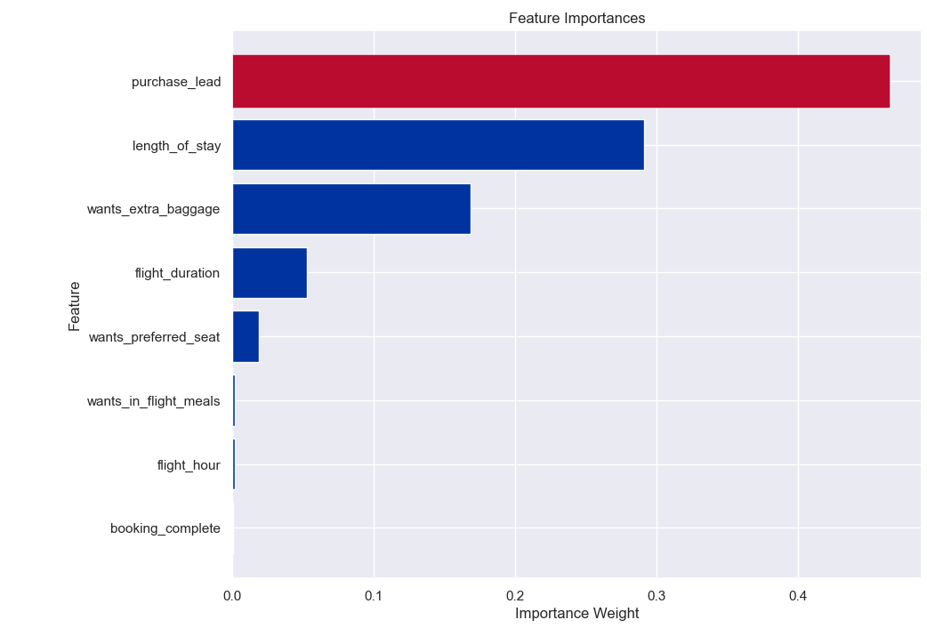
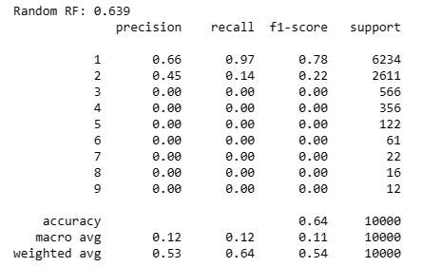
Evaluation
• The most important variable in the model was purchase lead, that is the time between purchase and departure.
• Information about the flight, e.g. flight time and duration was also significant, however booking origin of the customer was not important.
• The accuracy of the model was approximately 0.66 (Precision) and 0.97 (Recall)., with an F1 sore of 0.78 after hyperparameter tuning. I suggest adding more customer-centric features into the model.

